Slide 1

MEALS IN SLOVENIA

Slide 2
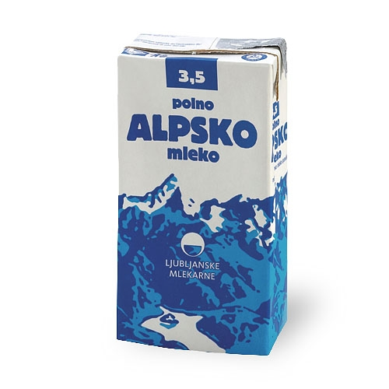
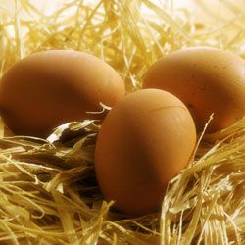
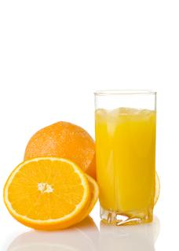
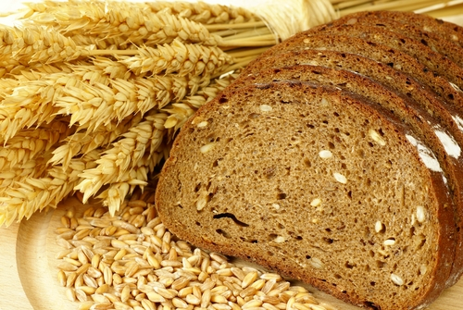
BREAKFAST
We usually eat breakfast from 7.00 to 9.00 o’clock.
For breakfast we usually eat bread, eggs, frankfurters, cheese and drink lemonade, milk, coffee, orange juice, tea,…

Slide 3
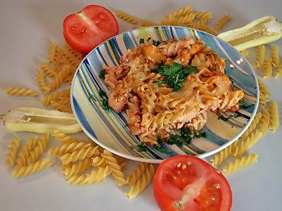
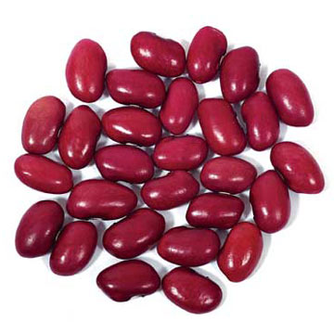
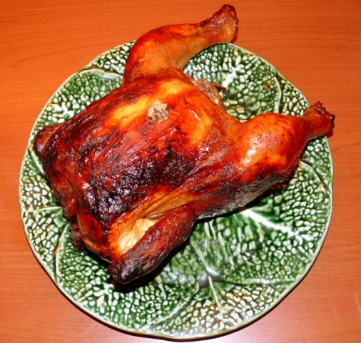
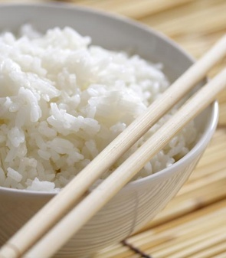
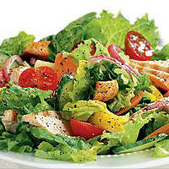
LUNCH
We eat lunch from 12.00 to 14.00 o’clock.
For lunch we eat chicken, lamb, pork, fish,
beef, tomatoes, pasta, rice, salad, beans,...

Slide 4


SNACKS
We eat snacks between the meals.
For snacks we eat chocolate, chrisps, salted sticks, cola, traditional Prekmurje cake,...

Slide 5
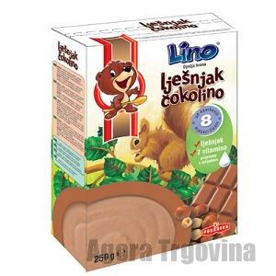
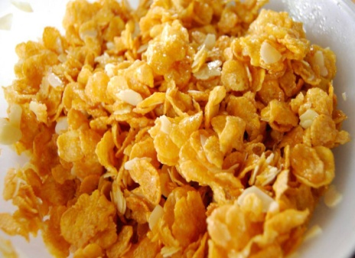

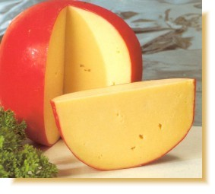
DINNER
We eat dinner from 18.00 to 20.00 o’clock.
For dinner we eat chocolate flakes, corn flakes, salad, sausages,….
We drink milk, orange juice, apple juice,…

Slide 6
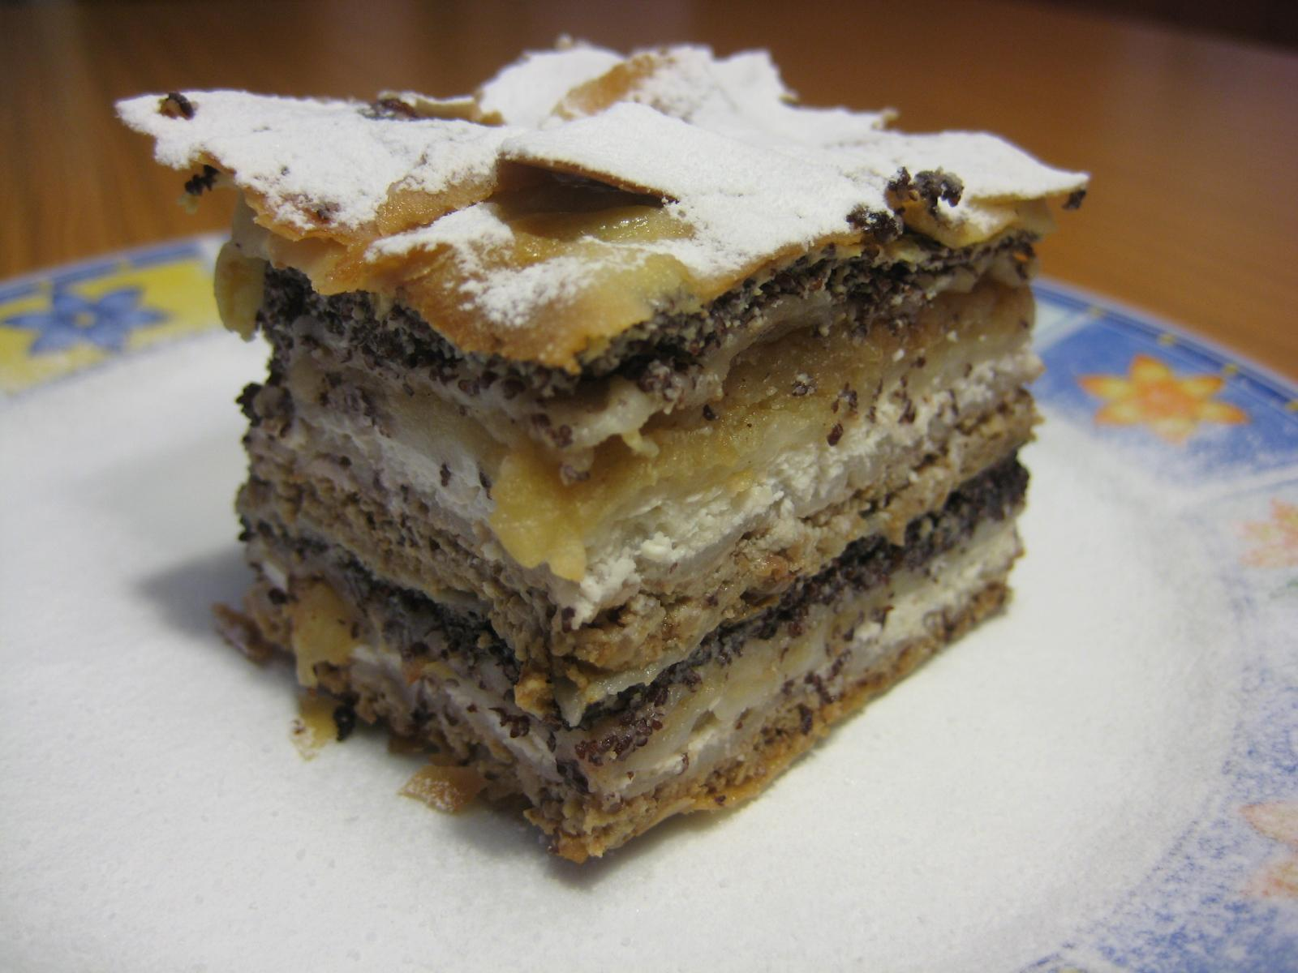
PREKMURJE CAKE
Ingredients:
- dough
- sugar
- apples
- grained poppy seeds
- curd
- sour cream
- butter

Slide 7
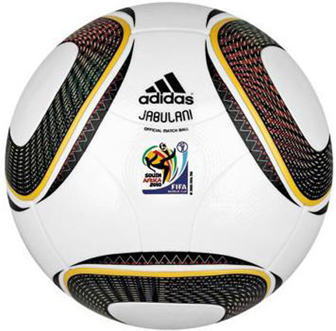
About me and my friend
We are Aljaž and Samo. We are 13 years old.
We like football and other sports. We don’t like school.

