Slide 1
ABOUT ME
Sabrina Ašenbrener

Slide 2
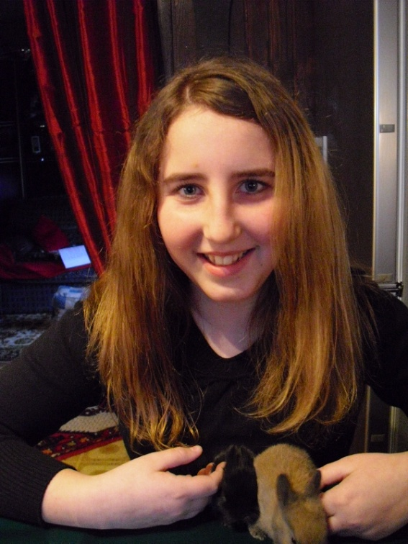
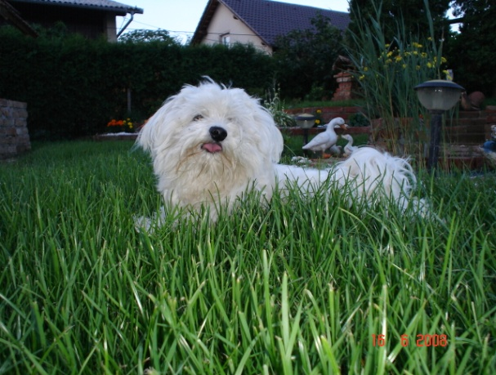
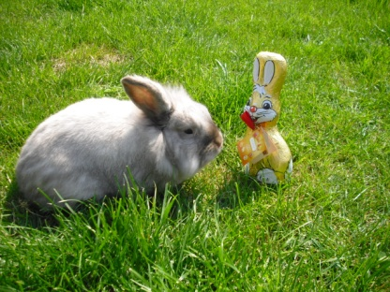
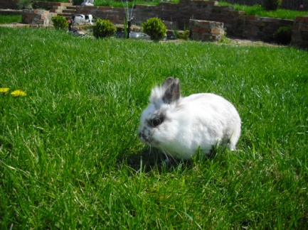
My name is Sabrina Ašenbrener.
I live in Slovenia (Beltinci).
I am 13 year old.
My hobbies are playing volleyball and playing with my animals.
My favorite animal is a dog
and a rabbit.
My dog Teddy
My rabbit Bigi
My rabbit Igi

Slide 3
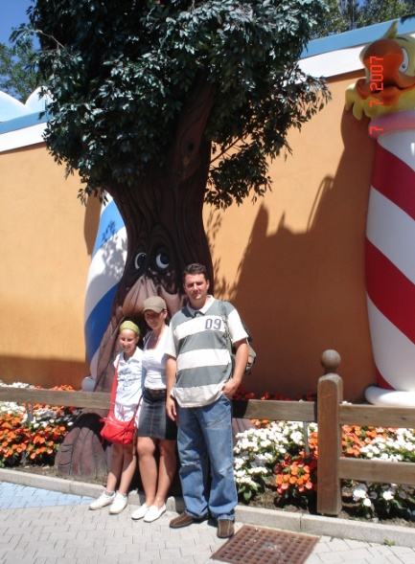
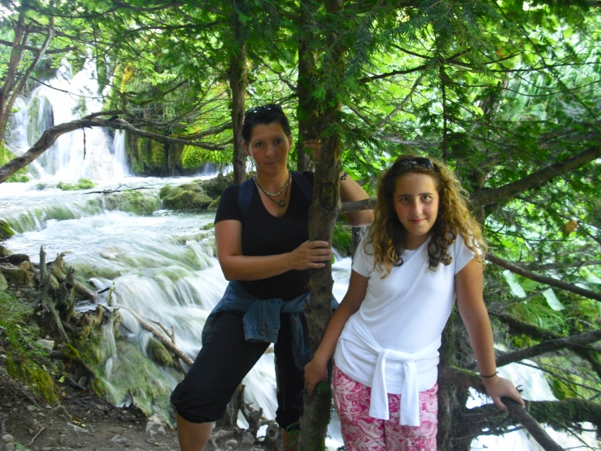
My family
My mother My father
Her name is Brigita. His name is Matjaž.
She is 37 years old. He is 38 years old.

Slide 4
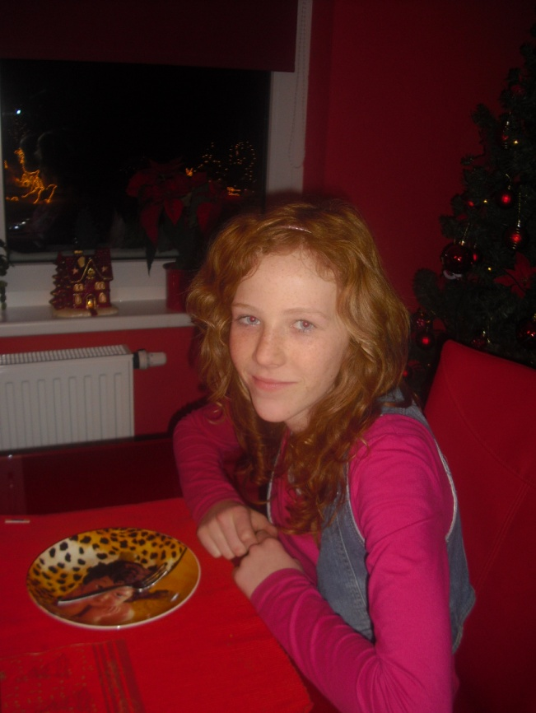
My best friend is Ines Horvat
Her hobbies are: playing volleyball, dancing ...

