Slide 1
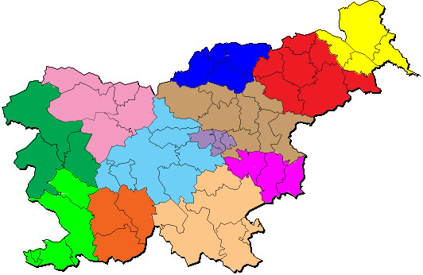
MEALS IN SLOVENIA

Slide 2
INTRODUCTION
IN SLOVENIA WE HAVE A LOT OF DIFFERENT KINDS OF FOOD. WE ALSO HAVE LOTS OF MEALS LIKE: BREAKFAST, LUNCH, DINNER AND BETWEEN THE MAIN MEALS THERE ARE SNACKS. IN THE NEXT SLIDES YOU HAVE THEM PRESENTED A LITTLE MORE DETAILED.

Slide 3
BREAKFAST
BREAKFAST IS THE FIRST MEAL OF THE DAY. IT’S BETWEEN 7 AND 10 O’CLOCK. THIS MEAL IS A LIGHT MEAL – IT MEANS THAT FOOD IS NOT VERY HEAVY. PEOPLE USUALLY EAT YOGURT, FRUIT, BREAD AND JAM, CEREAL AND DRINK MILK, TEA OR COFFEE.

Slide 4
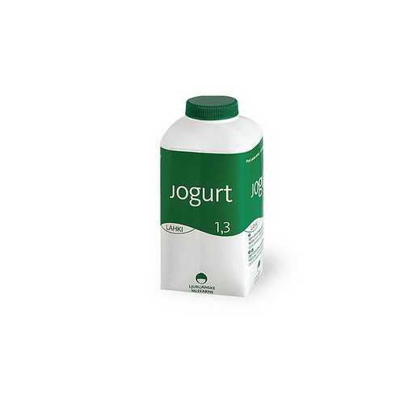

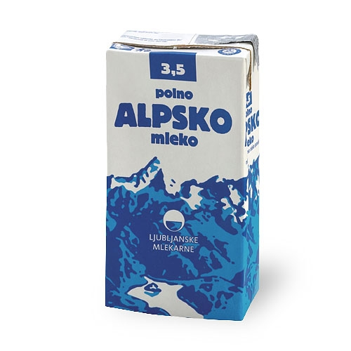
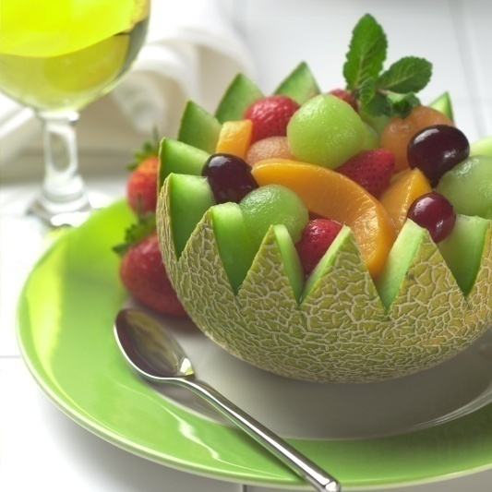
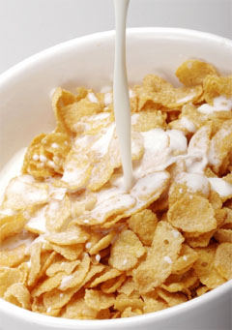
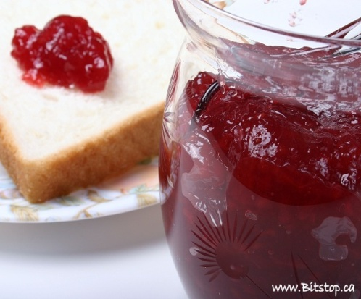
PICTURES OF BREAKFAST

Slide 5
LUNCH
LUNCH IS THE BIGGEST MEAL IN SLOVENIA. IT’S FROM 12 a.m. TO 2 p.m. WE EAT FOOD LIKE: BOGRAČ, GIBANICA, DÖDOLI, LANGAŠ, PIZZA, PASTA,… WE DRINK WINE, WATER, JUICE,… FOR DESERTS WE EAT GIBICE, ZLEVANKE, ICE CREAM, CHOCOLATE CUPCAKES, MUFFINS,…

Slide 6
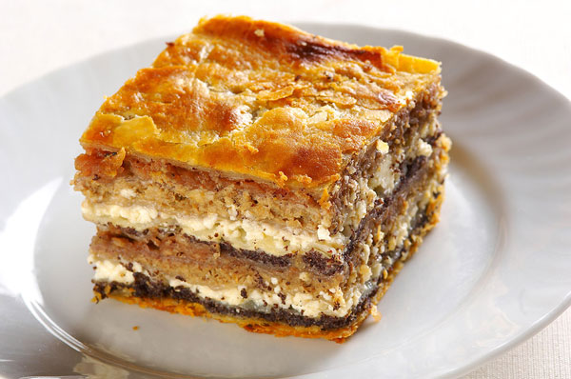
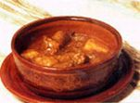
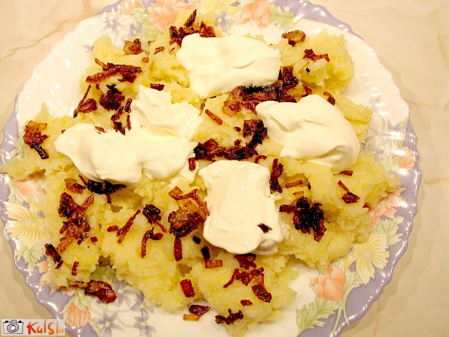
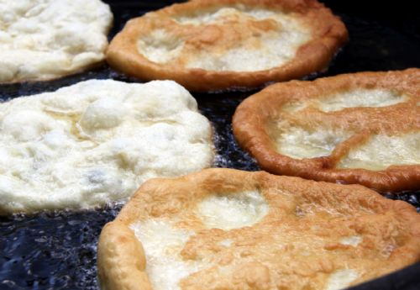
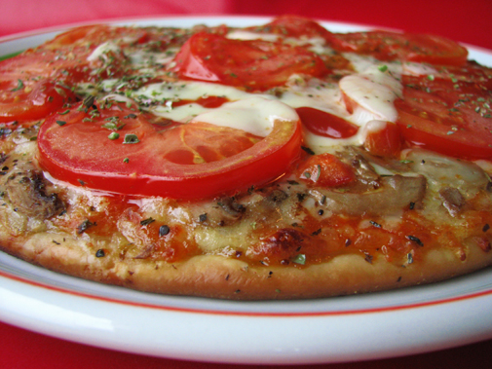
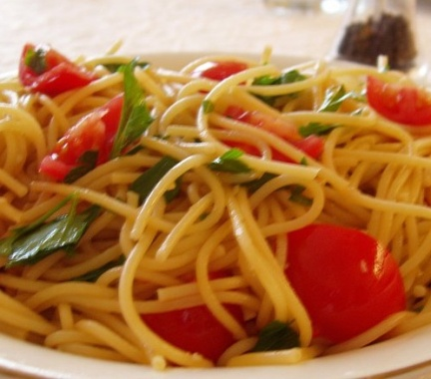
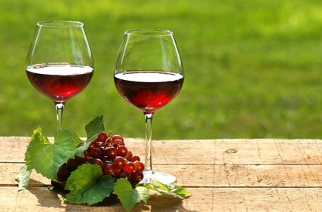
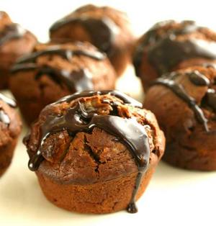
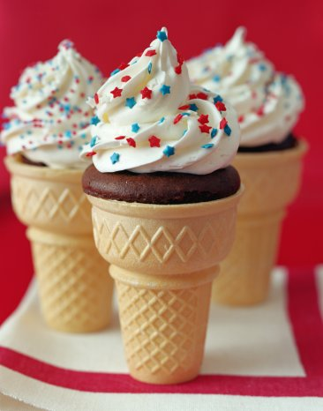
PICTURES OF LUNCH

Slide 7
DINNER
DINNER IS ALSO A SMALL MEAL LIKE BREAKFAST. IT’S FROM 5 p.m. TO 7 p.m. THE FOOD IS VERY LIGHT, LIKE FRUIT, MAYBE JUST A DRINK, LIKE MILK, HOT CHOCOLATE, TEA, COCOA,...

Slide 8
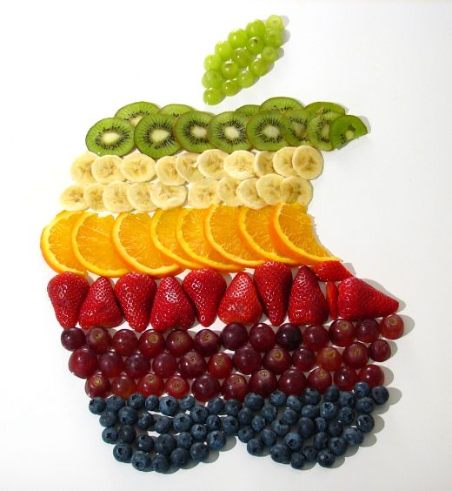
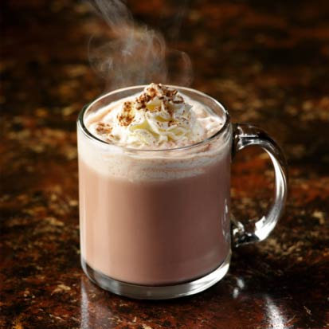
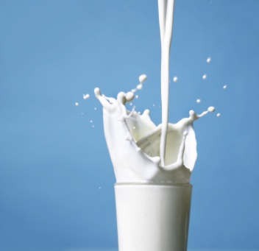
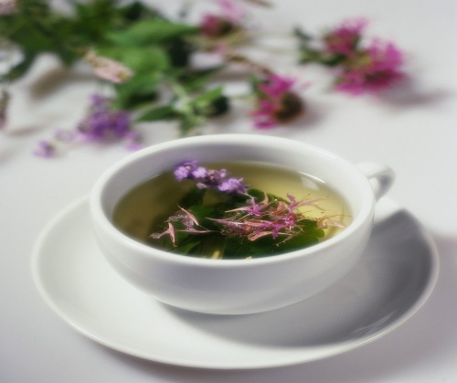
PICTURES OF DINNER

Slide 9
SNACKS
SNACKS ARE BETWEEN THE MAIN MEALS AND THEY AREN’T LIKE OTHER MEALS. FOR SNACKS WE EAT SANDWICHES, HOT DOGS, HAMBURGERS,… WE DRINK JUICE, COCA COLA, SPRITE, FANTA,…

Slide 10
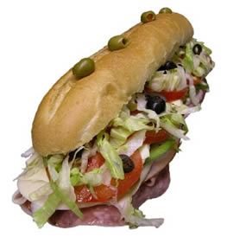
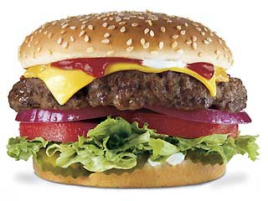
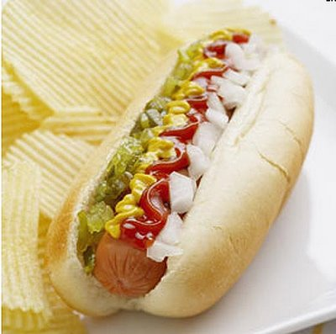
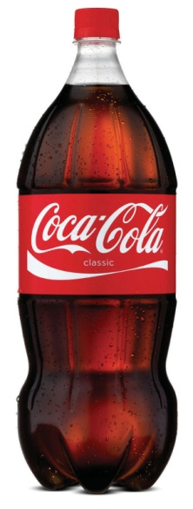
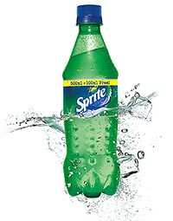


PICTURES OF SNACKS

Slide 11
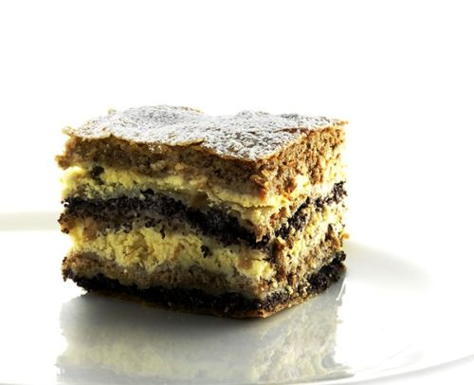
RECIPE FOR THE END
AT THE END WE WOULD LIKE TO PRESENT A DESERT WE LIKE TO EAT AND PREAPARE.
LET’S START!!

Slide 12
PREKMURSKA GIBANICA
INGREDIENTS:
Ingredients for dough:
30 g flour
salt
1.5 dl lukewarm water
2 tablespoons of oil
Poppy seed filling:
20 dag poppy
10 dag sugar
cinnamon to taste
1 dl hot milk

Slide 13
Cottage cheese filling:
50 dag curd
1 egg
1 dl sour cream
2 tablespoons raisins soaked in rum
a little vanilla
15 dag sugar
Walnut filling:
25 dag ground walnuts
10 dag sugar
a little cinnamon
Apple filling for strudel as we do. Grated apples sprayed with a little lemon juice, it does not oxidize, add sugar and grated lemon peel. Add
a little cinnamon

Slide 14
INSTRUCTIONS:
From the ingredients to make pastry dough, which must cover at least one hour rest. Then, stretch and cut the size of the baking. Make our work if we buy has certainly dough.
Grind poppy seeds and pour the hot milk. Stir in sugar and cinnamon and allow to cool. You can also stir in a little butter, then filling is better.
Brush baking tray with grease well, place the bottom of the stretched dough by spraying the fat, add another layer of dough and filling brush with poppy. After a given
another layer of dough, brush with cottage cheese filling, then again, the dough and sprinkle with nuts, then batter and then again apple filling. Each layer
spraying the dough with melted butter. Repeat all again at the top of the dough should be. Gibanica pour sour cream and bake for one hour at 180
degrees.

Slide 15
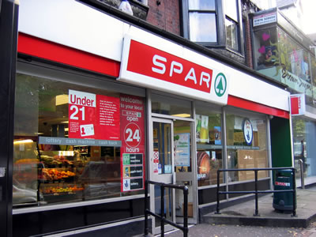
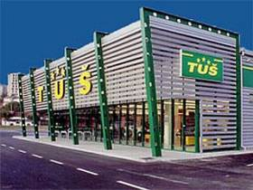
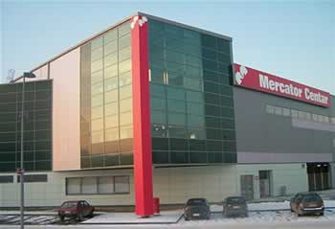
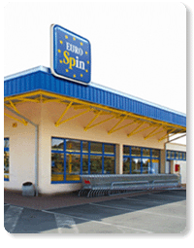
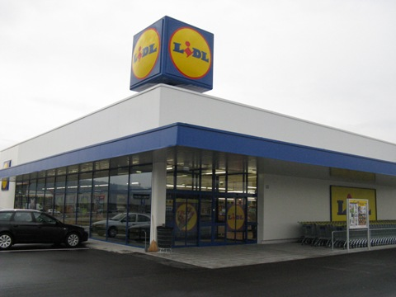
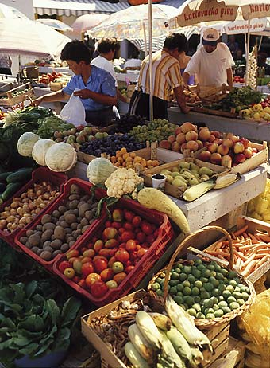
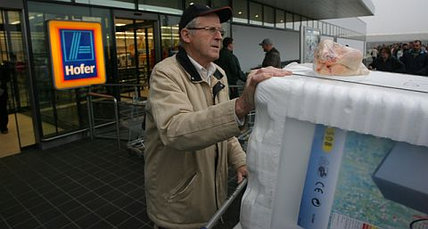
WHERE WE FIND FOOD IN SLOVENIA
ALL FOOD THAT WE SHOWED YOU BEFORE IS AVAILABLE IN STORES LIKE: INTERSPAR, SPAR, MERCATOR, TUŠ, LIDL, HOFER, EUROSPIN, AT MARKETS, …

Slide 16
AUTHORS: LEONIDA AND MOJCA
WE ARE 13 YEARS OLD. WE VISIT THE PRIMARY SCHOOL IN BELTINCI. WE BOTH LIKE ENGLISH. WE MADE THIS PRESENTATION FOR YOU TO HAVE FUN AND MEET THE MEALS IN OUR COUNTRY – SLOVENIA. HOPE YOU HAD FUN AND ENYOYED IT.
LEONIDA and MOJCA

