Slide 1
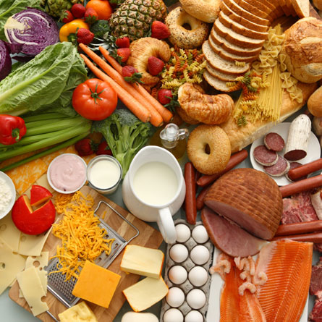
Meals in slovenia

Slide 2

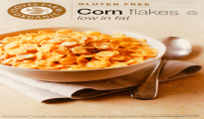


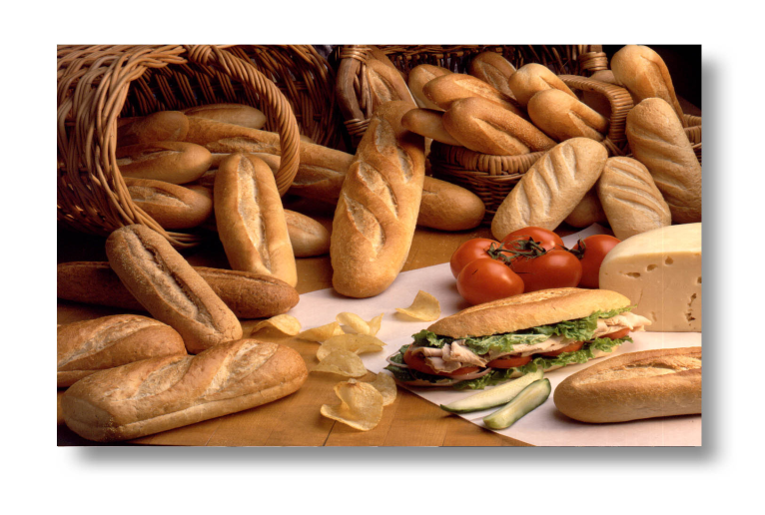
Breakfast
We usually eat breakfast from 7 to 9 o’clock.
we usually eat:
  Cornflakes
  Bread with: butter or margarine,
  jam, marmelade or honey

Slide 3
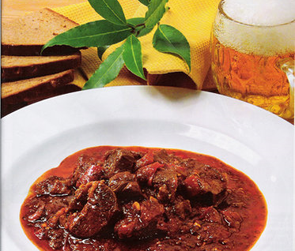



lunch
we usually
Eat it from 12 to 3 o’clock.

Slide 4

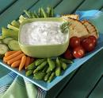
dinner
we eat dinner from 6 to 7 O’clock.
We usualy eat:
Fruit
Vegetables
Cornflakes
Yoghurt.

Slide 5
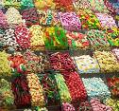
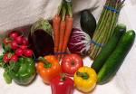
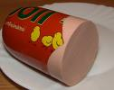
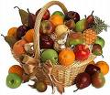
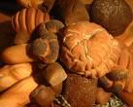



shopping
supermarket
market
Sweets
Snacks
Dairy products
School things
Meat
Fruit
Bread
Vegetables

Slide 6

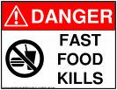


Fast food
You can see a funny video about fast food here: -A funny video
        -A funny video 1
A Popular fast food restaurant is mcdonlad’s.
You get fat from fast food.

Slide 7

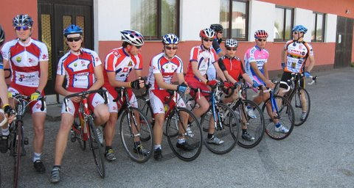


Matej and Jan
We are 13 years old.We visit the primary school Beltinci.
We like sports , computers .
Jan is a footballer
Matej is a cyclist
In our free time we play computer games
and watch films.
We like to eat chrisps,sandwiches,
Producers of this powerpoint video : matej & jan xD

Slide 8
RECIPE
SPAGhETTI WHITH TOMATO SaUCE
INGRIDIENTS:
2 onions
1 carrot
2 spoons of Olive oil
1 tommato
Salt
Pepper
Spaghetti
basil

Slide 9

SPAGhETTI WITH TOMATO SaUCE
INGReDIENTS:
2 onions
1 carrot
2 spoons of Olive oil
1 tomato
Salt
Pepper
Spaghetti
basil
Preparation:
Peel and chop the onions.
Wash and grate the carrots.
Heat the oil in a dish and fry the onions in it. Then add the carrots and 1 can of tomatoes in chunks.
cook all together for about 15 minutes. Add salt and pepper .
Cook the spaghetti in salted water, then drain them well. Mix them with the prepared sauce and garnish with the basil.

