Slide 1


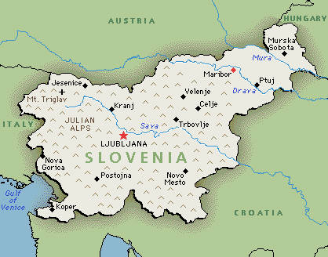
Meals in Slovenia

Slide 2
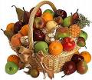

Breakfast:
For breakfast, we usually eat cereal or toast with butter and jam.We drink hot milk or juice.Some people have fruit and water for breakfast.That is very healty.Our parents drink coffee.

Slide 3
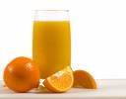
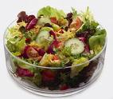

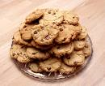
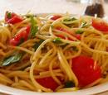
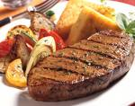
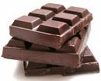
Lunch
For lunch we eat: soup, pasta, salad, steaks,…
We drink juice or water, cola, lemonade,…
After lunch we usually eat fruit or cookies or chocolate. That is very tasty. ☺

Slide 4




Dinner
For dinner we eat: cereal with milk or yoghurt, fruit, a sandwich, sausages, vegetables,…
We usually drink tea or milk. But some people drink juice or water. For special events,adults drink alcohol(champagne, wine, whisky…).

Slide 5

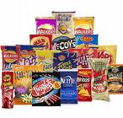
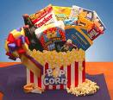
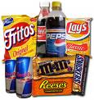
Snacks
We eat: sandwiches, chrisps, fruit,candies,chocolate, popcorn
We drink:
Cola, pepsi, orange juice, water.

Slide 6

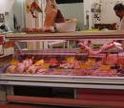
Shops
We buy food at a supermarket, a marketplace, a butcher`s…

Slide 7

Rija,Monika & Lara
We are 12 years old.We go to elementary school in Beltinci. We are now in 7.c class. Our favourite subjects are Art, English and PE.
Thank you for watching our presentation .☺

