Slide 1
About me

Slide 2
My name’s Jan Forjan.
I’m 11 years old.

Slide 3
I am from Melinci.
I am visiting the elementary school in
Beltinci. I am going to the 6 class.

Slide 4
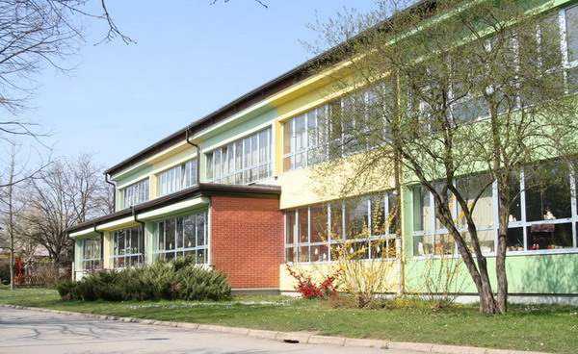
This is elementary school Beltinci.

Slide 5
I do judo.
I like playing computer games and watching
television.
My favourite school subject is Geography.
My favourite color is blue.
I like pizzas and beef.
I don’t like cauliflower.

Slide 6
My family

Slide 7
I have got one brother. His name’s Alen. He’s 14 years old.
My mum’s name is Milena. She’s 36.
My dad’s name’s Drago. He’s 38.
We live in a house. I share a room with my brother.

Slide 8
My grandma lives in our house. She is downstairs and we are upstairs.
We have got a pet, a dog named Kaja. She’s brown, black and white. I like playing with her.

Slide 9
Our food

Slide 10
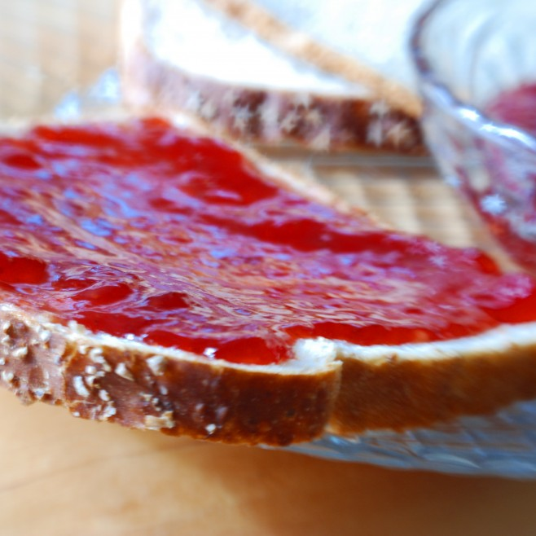
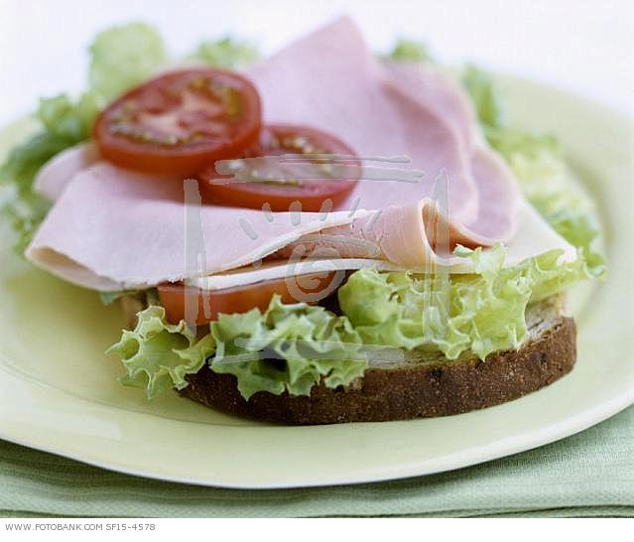
We usually eat bread with jam or a sandwich for breakfast.

Slide 11
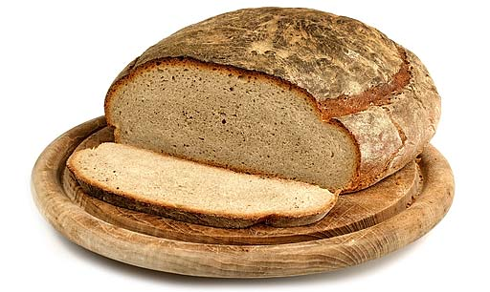
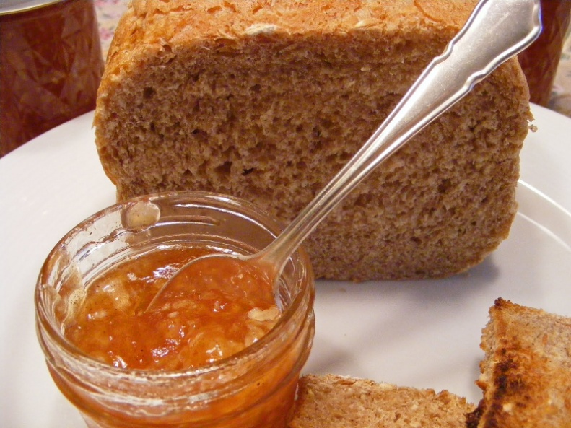
Bread with jam
1. You take a slice of bread.
2. You cover bread with jam and that’s all.
Bon appetit

Slide 12
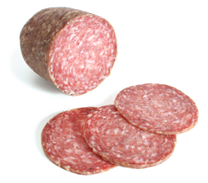
A sandwich
You take a slice of bread.
Then add some salami on it.
Bon appetit

Slide 13
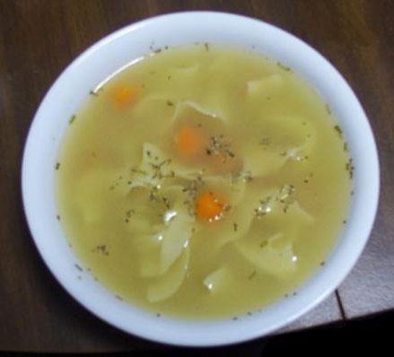
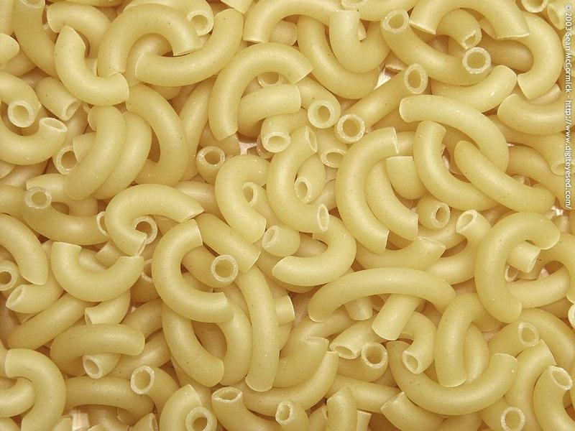
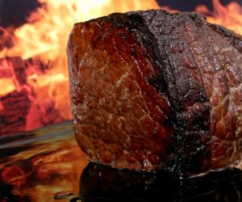
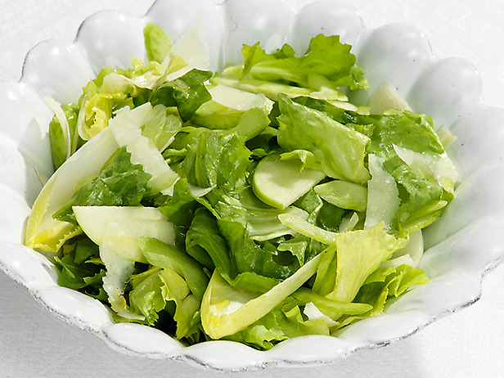
We usually eat soup, meat, pasta and salad for lunch.

Slide 14
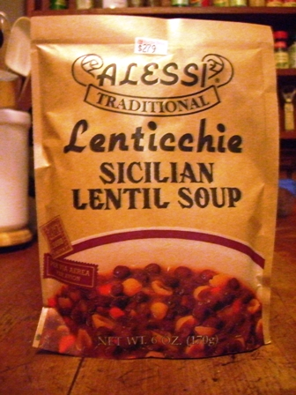
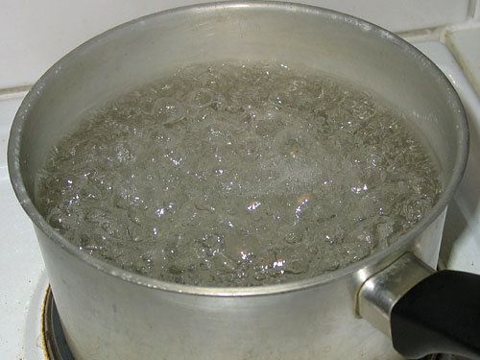
Soup
1. You put instant soup into some boiling water.
2. Boil it for five to eight minutes.
Bon appetit

Slide 15
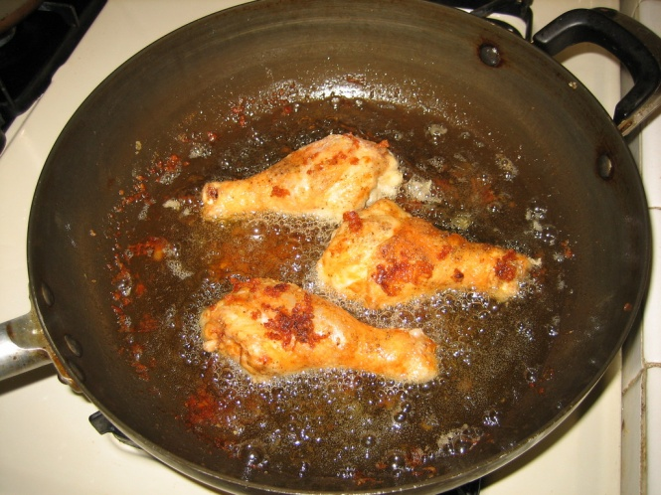
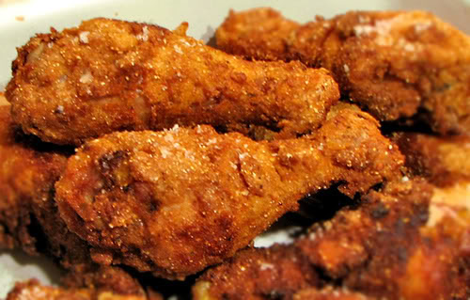
Chicken
meat
At first spice meat with some salt.
Heat some oil and put the meat in it and fry it on both sides.
3. Add some water and stew it for a
While.
Bon appetit

Slide 16
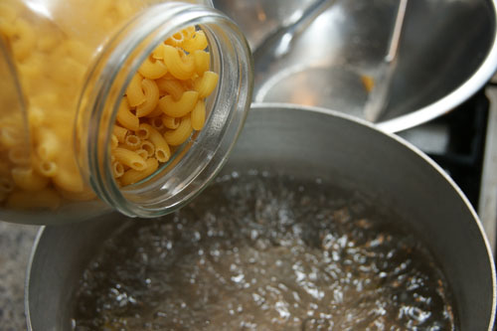
Pasta - macaroni
Boil some salted water.
Put in some macaroni and cook it for eight to ten minutes.
Bon appetit

Slide 17
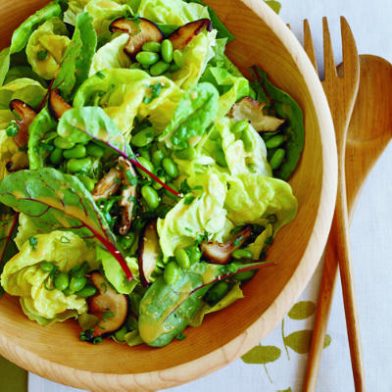
Salad
1. Cut some salad.
2. Wash it and add some salt, pumpkin oil and vinegar.
Bon appetit

Slide 18
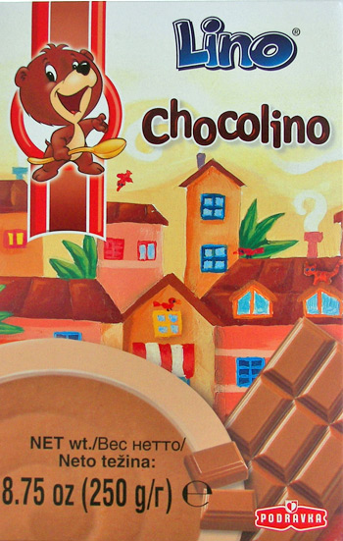
I usually eat chocolate flakes for dinner.
1. Just put some flakes into warm milk and mix them with a spoon.

Slide 19
THE END

