Slide 1
MEALS

Slide 2
About me
My name is Goran Pjevič I live in Slovenia. I´m 12 years old.I have
one brother and I have no sisters. In my free time I play computer games and watch TV. My favourite school subject is Geography.

Slide 3


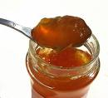
Brekfast
You take a bread
and you put margarine
and jam on it.

Slide 4
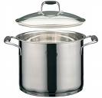






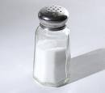
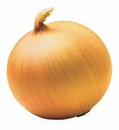
Lunch
You take a pot
and you put meat in it,
you put pepper in it,
you put red pepper in it,
you put parsley in it,
you put garlick in it,
you put onions in it,
you put salt in it,
you put spice in it,
you put the pot on a stove
and cook it from three to four hours.

Slide 5
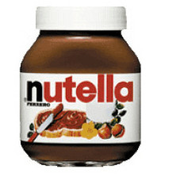
Dinner
You take a slice of bread
and you put nutella on it.

