Slide 1
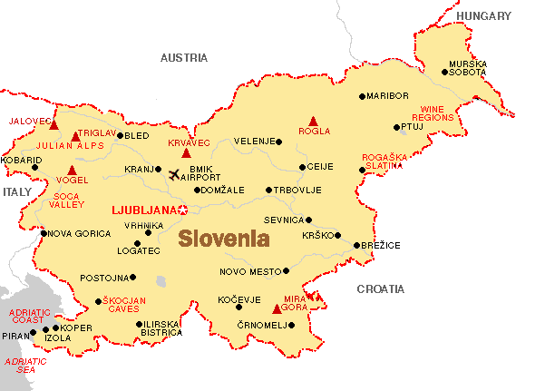
Meals in Slovenia

Slide 2
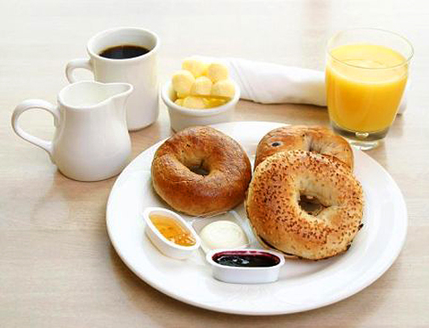


Breakfast
We eat breakfast from 7 to 8:30 o’clock.We eat toast with butter and jam. We drink cocoa with that.☺☺

Slide 3
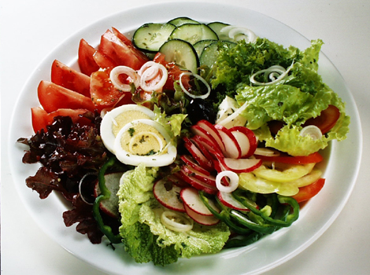
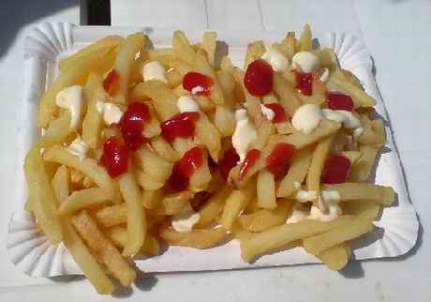
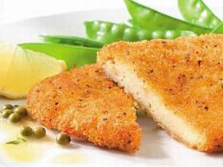


Lunch
We eat lunch from 12 to 13:30 o’clock.We eat meat, french fries, salad, fish. ☺☺

Slide 4
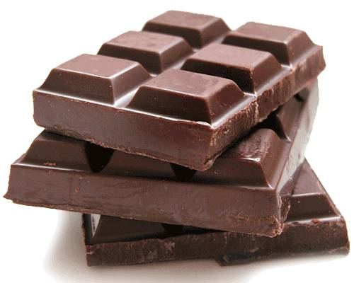
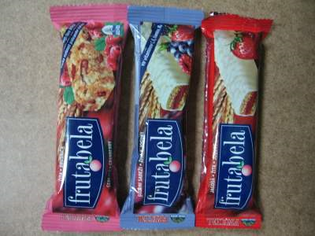
Snacks
We eat snacks when ever we want.We eat chocolate, fruit bars…☺☺

Slide 5
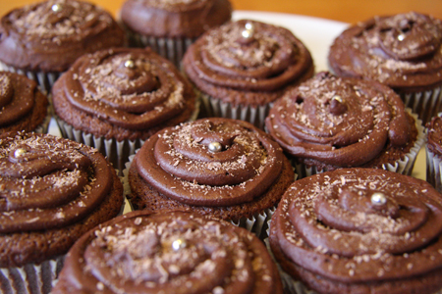
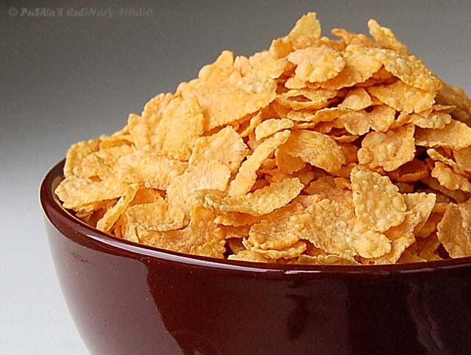
Dinner
We eat dinner from 6 to 6:45 o’clock. We eat chocolate flakes, corn flakes, cereal. ☺☺

Slide 6
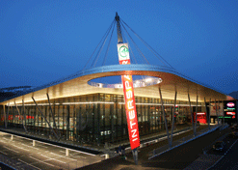
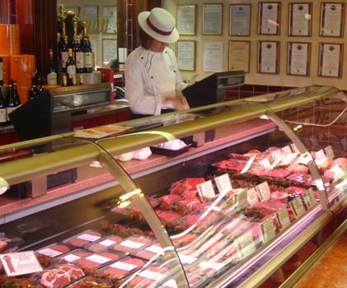
Were do we buy food☺
We buy food at the supermarket, butcher’s, baker’s, …

Slide 7

About me and my friend
My name is Damir Mlinarič and my friend is Gregor Jeric. We are 13 years old. We go to the same school - elementary school in Beltinci. Our school subjects are Maths, Slovene, English, Geography, History, Sport,…
We hope you enjoy our presentation. ☺☺
Bye

