Slide 1
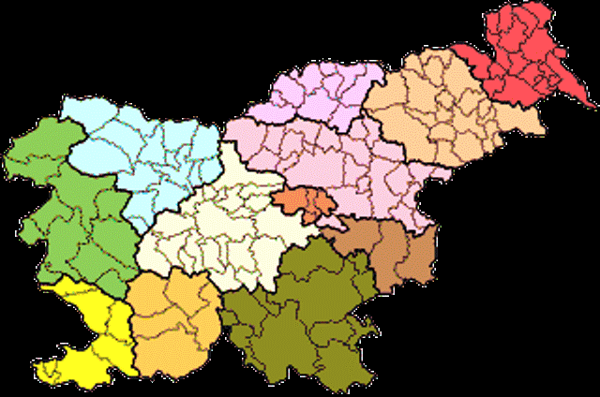

Meals in Slovenia

Slide 2
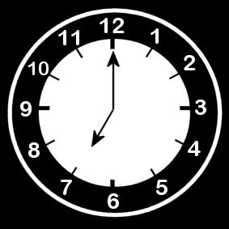
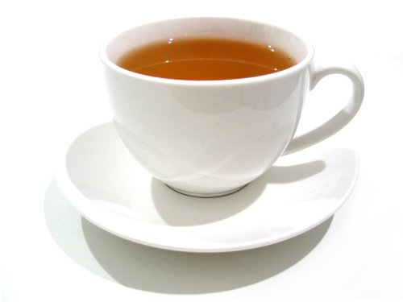
Breakfast
We usually eat breakfast
at seven o’clock. For breakfast some
people usually eat fruit, jam, toast, tea,
cereal and milk.

Slide 3
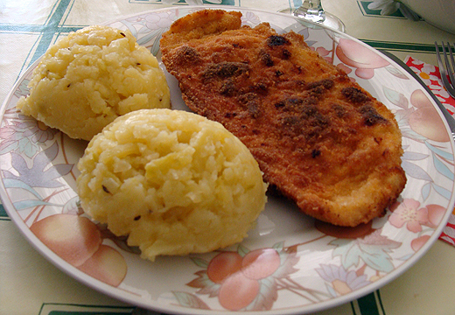
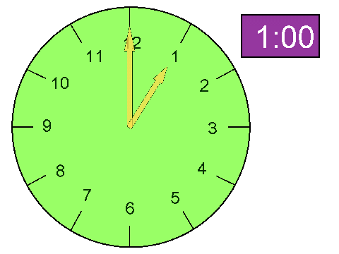
Lunch
we usually eat lunch between
12 o’clock and 13 o’clock .

Slide 4
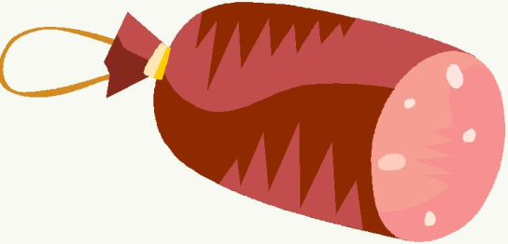
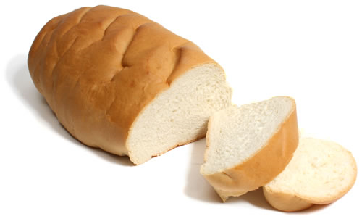
dinner
Some people eat light Food for dinner.
We usually eat dinner from 18 o’clock to 22 o ‘clock.
Some people usually eat bread with different spread,cereal in milk or bread with different kinds of salami for dinner.

Slide 5
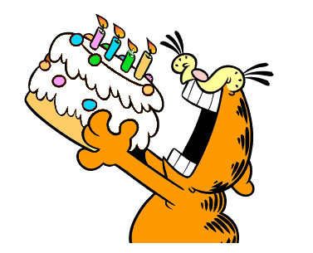
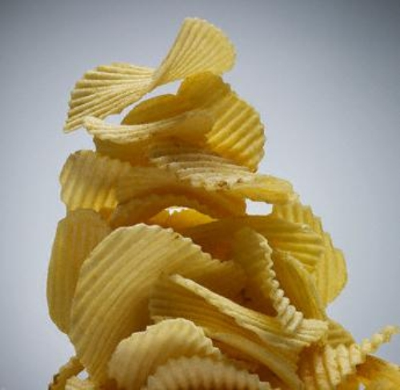
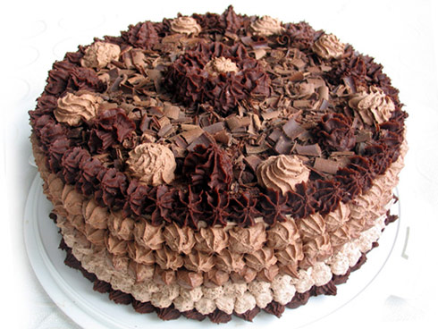
snacks
ALL PEOPLE IN THE WORLD EAT SNACKS.
We eat cakes, chocolate, ice cream, chrisps and sweets.

Slide 6



Fast food
SOME PEOPLE LIKE EATing FAST FOOD. We buy it at MC DO0NALD’S.
Happy meal
Fast food is: a cheeseburger, chips, a hot dog, an american burger, kebab …

Slide 7
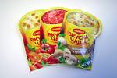

SHOPPING
SUPERMARKET | MARKET
HAM | MILK
JAM | BREAD
DRINKS | FRUIT
MEAT PRODUCTS | VEGETABLES
CORNFLAKES | INSTANT SOUP
Mr.Bean goes shopping

Slide 8
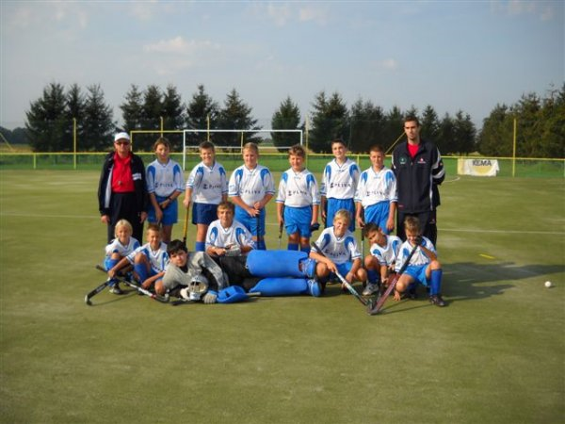
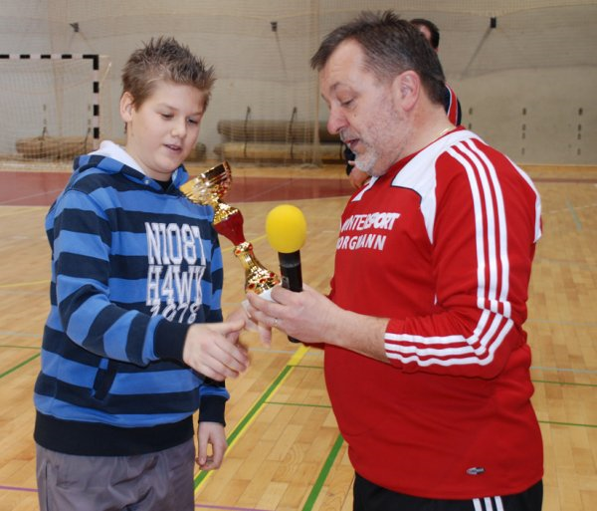
Tilen AND BLAŽ
We are 13 years old and we both play grass hockey. We both have one sister.

Slide 9

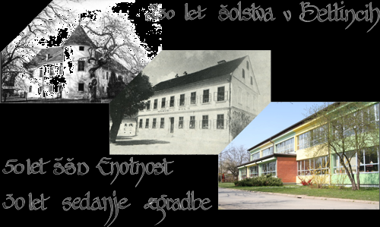
MY SCHOOL
WE BOTH GO TO THE PRIMARY SCHOOL IN BELTINCI.
Our favourite
SubjectS are SPORT,
GEOGRAphy, music,
teChnology.
Bye ☺ by tilen and blaZ

