Slide 1

CELEBRATING UNIVERSAL CHILDREN‘S DAY
20th November

Slide 2
the Convention on the Rights of the Child
21 years ago today a remarkable milestone for the protection and realization of the rights of all children - the Convention on the Rights of the Child – was officially opened for signature by United Nations Member States.
The Convention on the Rights of the Child (CRC) is the first legally binding instrument designed to protect and promote the rights of people under 18 years old. Its adoption by the UN General Assembly on 20 November 1989 is celebrated annually as Universal Children’s Day. It has now achieved near-universal acceptance, with ratification by 193 parties.
The Convention sets out rights that children enjoy as human beings and also identifies special rights and protections they require during this vulnerable phase of their lives.
There are 54 articles in the CRC. These set out universal human rights, including the rights to:
- survival
- develop to the fullest
- protection from harmful influences, abuse and exploitation
- participate fully in family, cultural and social life

Slide 3

UNIVERSAL CHILDREN‘S DAY
It was established in 1954.
It promotes international togetherness and awareness among children worldwide.
UNICEF coordinates and promotes this special day each year on November 20th.
This day also promotes the
welfare of the world’s children.

Slide 4
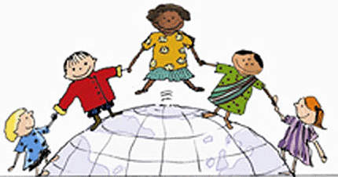


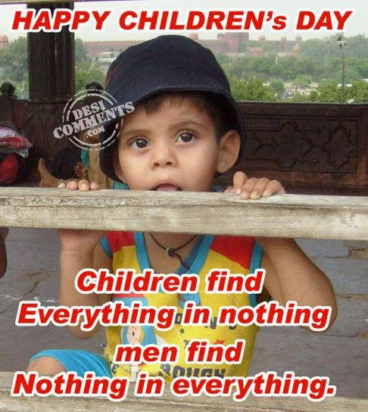

Slide 5

FACTS
On December 14, 1954, the UN General Assembly recommended that all countries should introduce an annual event from 1956 known as Universal Children's Day.
Many of the countries respected this recommendation and the Universal Children's Day has since been annually observed on November 20.

Slide 6
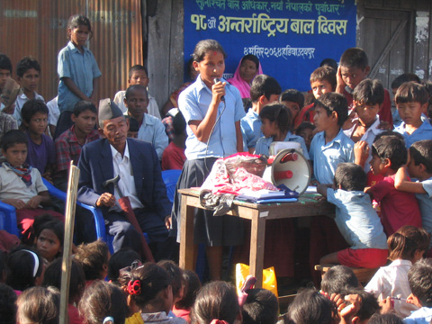
WHAT DO PEOPLE DO ABOUT IT?
Many schools and other educational iinstitutions make a special effort to inform children of their rights.
In some areas UNICEF holds events to draw particular attention to children's rights.
Many countries, including Canada, New Zealand and the United Kingdom, hold Universal Children's Day events on November 20.

Slide 7
VIDEO: “The State of the World’s Children” (2009)
http://www.unicef.org/rightsite/sowc/
The video addresses the progress that has
been made in the last 20 years and the role the
Convention can fulfill moving forward into the
future.

Slide 8
PROJECTS AND EVENTS to celebrate the children’s day

Slide 9

WHAT IS BBC‘S PROJECT CHILDREN IN NEED?
It is an annual British charity appeal organised by the BBC
Since 1980 it has raised over £500 million.

Slide 10
This annual event aims to raise money to help improve the lives of those disadvantaged children and young people all over the UK.
In 2009 they collected almost 40 million pounds
THE 2010 SHOW
was held on the evening of Friday 19November,
hosted by Terry Wogan, Tess Daly and Fearne Cotton,
through to the morning of Saturday 20 November
2010. This year it marks the 30th anniversary of the
television telethone.
Many popular singers and groups appeared on
Stage, including Take That, Cherly Cole, Kylie
Minogue, Susan Boyle, JLS etc.

Slide 11
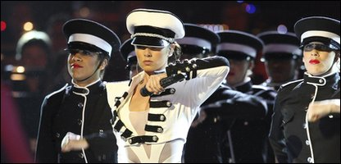
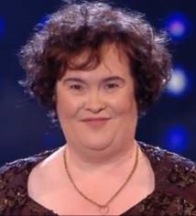
Videos from the show:
http://www.youtube.com/watch?v=XiSZMm-L3fw (Take That)
http://www.youtube.com/watch?v=CoAl-XRDuYM&feature=related (Cheryl Cole)
http://www.youtube.com/watch?v=070wp0fzpxc (Kylie Minogue)
A message of Lewis Hamilton: http://www.youtube.com/watch?v=qjUXEltyIYw

Slide 12

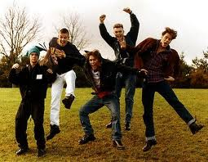
TAKE THAT:
LIVE ON CHILDREN IN NEED
Take That was performing 'The Flood' and their classic hit 'Never Forget' on Children In Need on Friday 19th November on BBC1!
http://www.youtube.com/watch?v=Y7A3WD80N8E
http://www.youtube.com/watch?v=vQx_CvPJwQo

Slide 13
UNIVERSAL CHILDREN’S DAY IN MEDIA
http://www.unicef.org/media/media_56934.html
http://acelebrationofwomen.org/?p=32791
http://www.kulone.com/GH/Event/1023103-Universal-Children%27s-Day-2010
http://english.ruvr.ru/2010/11/20/35327018.html
http://www.crin.org/resources/infodetail.asp?id=23540
http://www.sussex.ac.uk/staff/newsandevents/index.php?id=6011
http://www.opportunity.org/blog/today-we-celebrate-universal-childrens-day/
http://www.ehow.com/how_4605736_celebrate-universal-childrens-day.html
http://www.indianchild.com/childrens_day_india.htm
http://www.pepe.com/en/events/universal-childrens-day-141

Slide 14
Sources
http://www.timeanddate.com/holidays/un/universal-childrens-day
http://www.google.si/imgres?imgurl=http://www.advocacynet.org/modules/fck/upload/image/Partners/cocap/protest.jpg&imgrefurl=http://www.advocacynet.org/page/nespecnews&usg=__zhplPX1fy1f2I9UJNdjqg78RBYY=&h=360&w=480&sz=131&hl=sl&start=0&zoom=1&tbnid=W6ZpvknrGtxgLM:&tbnh=115&tbnw=153&prev=/images%3Fq%3Duniversal%2Bchildren%2527s%2Bday%26hl%3Dsl%26biw%3D729%26bih%3D487%26gbv%3D2%26tbs%3Disch:1&itbs=1&iact=rc&dur=187&ei=60XmTP2MMcyZOrCKqaMK&oei=QUPmTPeSD8acOu-MwZUK&esq=8&page=1&ndsp=12&ved=1t:429,r:0,s:0&tx=123&ty=87
http://www.google.si/imgres?imgurl=http://www.wristbandconnection.com/wristbands-events/uploaded_images/universal-children-day-bracelet-774945.gif&imgrefurl=http://www.wristbandconnection.com/wristbands-events/2009/11/universal-childrens-day-20th-november.html&usg=__qmiKla2UvnepQxhq7kImuVlNY4Y=&h=412&w=304&sz=51&hl=sl&start=0&zoom=1&tbnid=V2-xLVO_hzMzzM:&tbnh=115&tbnw=85&prev=/images%3Fq%3Duniversal%2Bchildren%2527s%2Bday%26hl%3Dsl%26biw%3D729%26bih%3D487%26gbv%3D2%26tbs%3Disch:1&itbs=1&iact=hc&vpx=277&vpy=32&dur=1391&hovh=261&hovw=193&tx=94&ty=203&ei=QUPmTPeSD8acOu-MwZUK&oei=QUPmTPeSD8acOu-MwZUK&esq=1&page=1&ndsp=12&ved=1t:429,r:1,s:0
http://www.google.si/imgres?imgurl=http://bolly7.net/wp-content/uploads/2010/11/Children-Day.jpg&imgrefurl=http://bolly7.net/children%25E2%2580%2599s-day-sms-quotes-wishes.html&usg=__SdE7G01s0o6K_aDJ-ngeDD6Mop8=&h=354&w=703&sz=62&hl=sl&start=0&zoom=1&tbnid=UrGSfAeab06pGM:&tbnh=77&tbnw=152&prev=/images%3Fq%3Dchildren%2527s%2Bday%26hl%3Dsl%26biw%3D729%26bih%3D487%26gbv%3D2%26tbs%3Disch:1&itbs=1&iact=hc&vpx=83&vpy=76&dur=19312&hovh=159&hovw=317&tx=155&ty=79&ei=vUvmTMnKJcqdOrytiYwK&oei=vUvmTMnKJcqdOrytiYwK&esq=1&page=1&ndsp=13&ved=1t:429,r:0,s:0
http://www.google.si/imgres?imgurl=http://www.westreap.org.nz/images/clip_image001_002.gif&imgrefurl=http://www.westreap.org.nz/ChildrensDay2010.aspx&usg=__VmvCkJbrkKSma3agqkDKL9nsZN4=&h=256&w=799&sz=46&hl=sl&start=0&zoom=1&tbnid=LgtAvzq4ysCfzM:&tbnh=45&tbnw=139&prev=/images%3Fq%3Dchildren%2527s%2Bday%2B2010%26hl%3Dsl%26biw%3D729%26bih%3D487%26gbv%3D2%26tbs%3Disch:1&itbs=1&iact=rc&dur=235&ei=Nk_mTLjCNI6bOq3RqJUK&oei=Nk_mTLjCNI6bOq3RqJUK&esq=1&page=1&ndsp=13&ved=1t:429,r:1,s:0&tx=73&ty=26
http://www.google.si/imgres?imgurl=http://www.sphoorti.org/style/img/childrens-day.gif&imgrefurl=http://www.sphoorti.org/gallery.html&usg=__gUoZob_qDh7jfU_Qqftpvb405-k=&h=296&w=612&sz=47&hl=sl&start=0&zoom=1&tbnid=PXc8ddMrE2HASM:&tbnh=65&tbnw=135&prev=/images%3Fq%3Dchildren%2527s%2Bday%26hl%3Dsl%26biw%3D729%26bih%3D487%26gbv%3D2%26tbs%3Disch:1&itbs=1&iact=rc&dur=141&ei=vUvmTMnKJcqdOrytiYwK&oei=vUvmTMnKJcqdOrytiYwK&esq=1&page=1&ndsp=13&ved=1t:429,r:1,s:0&tx=75&ty=55
http://www.google.si/imgres?imgurl=http://www.i-am-youth.com/wp-content/uploads/2010/11/childrens-day-india-7.gif&imgrefurl=http://www.i-am-youth.com/happy-childrens-day-2010-sms-quotes-greeting-cards-wallpapers/735/childrens-day-india-7/&usg=__-01tJrTP-uLaGEKVKOYdaCjOjKg=&h=350&w=550&sz=83&hl=sl&start=0&zoom=1&tbnid=znY_9y8AtSJqoM:&tbnh=88&tbnw=139&prev=/images%3Fq%3Dchildren%2527s%2Bday%2B2010%26hl%3Dsl%26sa%3DG%26biw%3D729%26bih%3D487%26gbv%3D2%26tbs%3Disch:1&itbs=1&iact=rc&dur=219&ei=kk_mTNG1EsyYOsD7ubEN&oei=kk_mTNG1EsyYOsD7ubEN&esq=1&page=1&ndsp=13&ved=1t:429,r:2,s:0&tx=86&ty=48

Slide 15
SOURCES:
http://www.google.si/imgres?imgurl=http://www.lingeyhouseprimary.org/Children%2520In%2520Need.gif&imgrefurl=http://www.lingeyhouseprimary.org/downloads_and_resources/teachers_resources/&usg=__kecjiOhoBf-2lRLF_1R6gUAwWSc=&h=376&w=945&sz=22&hl=sl&start=0&zoom=1&tbnid=Sl4ljbT9bo60oM:&tbnh=56&tbnw=142&prev=/images%3Fq%3Dchildren%2Bin%2Bneed%26hl%3Dsl%26biw%3D729%26bih%3D487%26gbv%3D2%26tbs%3Disch:1&itbs=1&iact=hc&vpx=149&vpy=93&dur=812&hovh=141&hovw=356&tx=161&ty=90&ei=IVbmTKSQLcaEOuXngYYK&oei=IVbmTKSQLcaEOuXngYYK&esq=1&page=1&ndsp=14&ved=1t:429,r:1,s:0
http://news.bbc.co.uk/cbbcnews/hi/newsid_9200000/newsid_9208300/9208337.stm
http://www.unicef.org/media/media_56934.html

Slide 16
The presentation was made by:
MONIKA PRAŠNIKAR
ANA LAMBERŠEK
ROMANA KOŠENINA
from
PRIMARY SCHOOL RODICA, SLOVENIA
19th and 20th November 2010

